Slide 1
SAS Reverse KT
SUB QUERIES IN PROC SQL

Slide 2
The SAS SQL Procedure
Implementation of Structured Query Language in SAS environment called PROC SQL.
PROC SQL uses SQL to create, modify, read, update tables and retrieve data from tables and views (and SAS data sets).
PROC SQL can be used on SAS files, flat files, VSAM files, database tables, and combinations of these to do query operations.
Basic syntax:
PROC SQL < option < option > …
ALTER alter-statement;
CREATE create-statement;
DELETE delete-statement;
DESCRIBE VIEW view-name;
DROP drop-statement;
INSERT insert-statement;
SELECT select-statement;
UPDATE update-statement;

Slide 3
Elementary PROC SQL Syntax for Queries
The most frequently-encountered usage for PROC SQL is to provide a query to one
or more SAS Data Files or SAS Data Views.
This is accomplished by means of a SELECT statement.
SELECT column-1, column-2, …
FROM table-a, table-b, …
WHERE expression
ORDER BY column-r, column-s, … ;
PROC SQL ;
SELECT DIVNUM, DIVNAME, EMPNUM, EMPNAME,
HIREDATE, RACE, SEX, BIRTHDAT, HADDR, HCITY,
HSTATE, HZIP, HPHONE, CLASSCD, EMPLTYPE, MOSALRY
FROM DIVISION AS A, EMPLOYEE AS B, JOBV AS C
WHERE DIVNUM IN (14, 19) AND DIVENDDT IS NULL AND DIVNUM=DIVNUM AND POSITION=POSITION AND TERMDATE IS NULL AND JOBBEGDT>=’01SEP1997’D AND JOBENDDT IS NULL ORDER BY DIVNUM, EMPNUM;
PROC SQL ;
SELECT * FROM EMPLOYEE;
Easy one

Slide 4
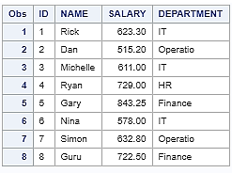
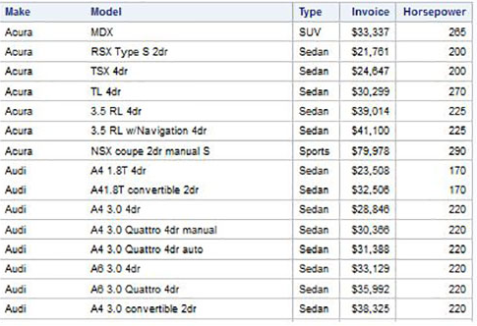
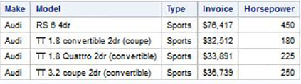
Elementary PROC SQL Syntax for Queries
1
DATA TEMP;
INPUT ID $ NAME $ SALARY DEPARTMENT $;
DATALINES;
1 Rick 623.3 IT
2 Dan 515.2 Operations
3 Michelle 611 IT
4 Ryan 729 HR
5 Gary 843.25 Finance
6 Nina 578 IT
7 Simon 632.8 Operations
8 Guru 722.5 Finance
;
RUN;
PROC SQL;
CREATE TABLE EMPLOYEES AS
SELECT * FROM TEMP;
QUIT;
2
PROC SQL;
SELECT make, model, type, invoice, horsepower
FROM SASHELP.CARS
Where make = 'Audi' and Type = 'Sports' ;
QUIT;

Slide 5
Quick SQL Syntax
DISTINCT
PROC SQL;
SELECT DISTINCT CLASSCD FROM JOBV;
Quit;
TEMPORARY COLUMNS
PROC SQL ;
SELECT EMPNUM, POSITION, INT((TODAY()-HIREDATE)/365.25) AS EMPYRS
FROM EMPLOYEE;
Quit;
WHERE CLAUSE
PROC SQL ;
SELECT EMPNUM, EMPNAME, HADDR, HZIP, HPHONE
FROM EMPLOYEE
WHERE TERMDATE IS NULL AND HCITY=’AUSTIN’ ;
Quit;
ORDER BY CLAUSE
PROC SQL ; SELECT POSITION, CLASSCD, MOSALRY, EMPNUM, EMPNAME FROM JOBV AS A EMPLOYEE AS B,
WHERE DIVNUM = 19 AND JOBENDDT IS NULL AND POSITION=POSITION AND TERMDATE IS NULL
ORDER BY EMPNAME;
Quit;
STATISTICAL
PROC SQL ;
SELECT FREQ(EMPNUM) AS COUNT,
FROM EMPLOYEE
WHERE TERMDATE IS NULL;
Quit;

Slide 6
SUBQUERIES
A subquery is a query-expression that is nested as part of another query-expression.
Subqueries usually involve a WHERE or HAVING clause which contains its own SELECT clause, and which is enclosed in parentheses.
PROC SQL ;
SELECT EMPNUM, EMPNAME, POSITION, HIREDATE FROM EMPLOYEE
WHERE TERMDATE IS NULL AND POSITION IN
( SELECT POSITION FROM PRSLIB.JOBV
WHERE JOBENDDT IS NULL AND EMPLTYPE=’RF’ )
ORDER BY EMPNUM ;
QUIT;

Slide 7
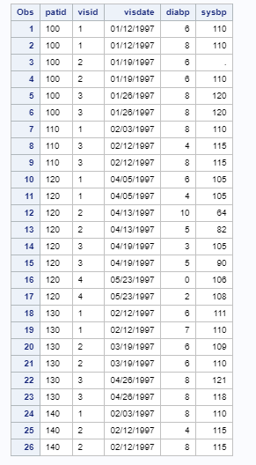
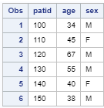
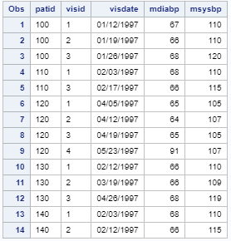
DATA SET
Demog Data Set
Vital
Data Set
Vitamin Data Set

Slide 8


Question and Solutions
Question 1
Find the patients who have records in table DEMO but not in table VITAL
Solution
Output
Proc SQL;
Select patid from demog Where patid not in (select patid from vital);
Question 2
Find patients who didn’t have their blood pressures measured twice at a visit.
Solution
Output
Proc SQL;
select patid from vital T1 where 2>(select count(*) from vital T2 where T1.patid=T2.patid and T1.visid=T2.visid);

Slide 9

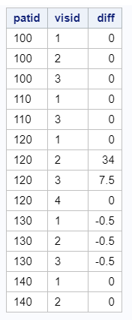
Question 3
Find patients whose age is in the average age +/- 5 years.
Solution
Output
Proc SQL;
Select patid from demog where age between (select Avg(age) from demog)-5 and (select avg(age) from demog)+5;
Question 3
Compute the difference between recorded mean of SYSBP from VITMEAN table and calculated mean of SYSBP from VITAL for each patient and visit.
Solution
Output
Proc SQL; Select a.patid, a.visid, a.msysbp - (select avg(sysbp) from vital as b where a.patid=b.patid and a.visid=b.visid) as diff from vitmean as a;

Slide 10
Thank you
Himanshu Kumar Sharma
(742711)

Slide 11
data ae;
set sasuser.ae;
Date1=input(compress(AESTDT), date9.);
format date1 date9.;
Date2=input(compress(AEENDT), date9.);
format date2 date9.;
where AETERM ne 'Infection' and not missing(AETERM);
run;
proc sort data= ae;
by subject;
run;
data ast;
set sasuser.ast;
Date3=input(compress(ASTSTDT), date9.);
format date3 date9.;
where ASTTRIG1 eq '1' ;
run;
proc sort data= ast;
by subject;
run;
data EFC14153_AE_AST_001_M;
merge ae ast;
by subject;
error_text='"Infection (e.g. colds, flu)" is marked as trigger factor, but there is no any related AE reported. Please check and update as appropriate.';
if date1 ne '.' and date2 ne '.' and date3 ne '.' then do;
if date1 eq date3 or date1 lt date3 lt date2 then output EFC14153_AE_AST_001_M;
end;
keep SUBJECT AETERM ASTTRIG1 AESTDT ASTSTDT AEENDT error_text;
run;
proc print data=EFC14153_AE_AST_001_M;
run;

